Slide 1

Data Science Engineering Methods and Tools
Raj Sarode 002762015

Slide 2
Problem Statement & Approach
Problem Statement: Scrape about 10,000 reviews on any product of your choice and label each review as negative if its rating is 1 or 2, else positive if its rating is 4 or 5. Build an NBC classifier and evaluate the performance with 80/20 split. Please make sure to apply tokenization and stemming for preparing the textual review
Approach:
Perform web scrapping using beautiful soup.
Trained the scraped reviews NBC model on the training set.
Outcome:
Perfectly received reviews for a movie.
Achieved accuracy of after successfully executing the reviews on NBC.

Slide 3
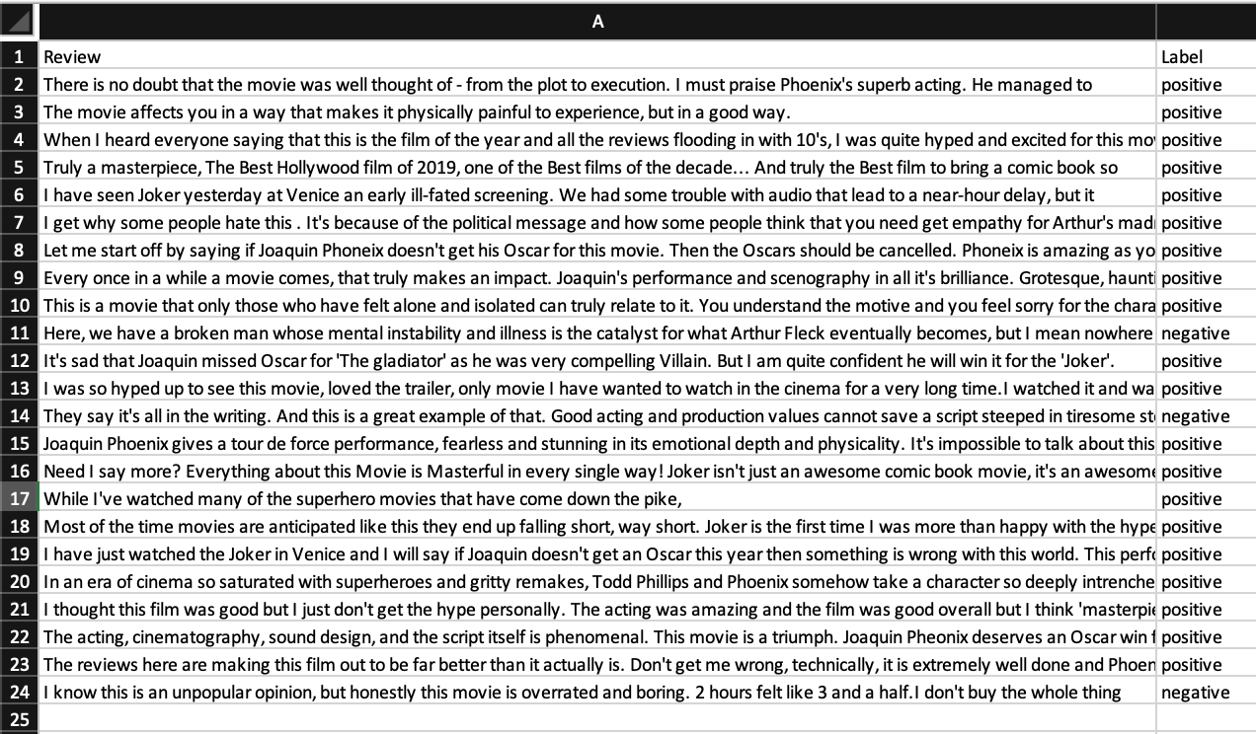
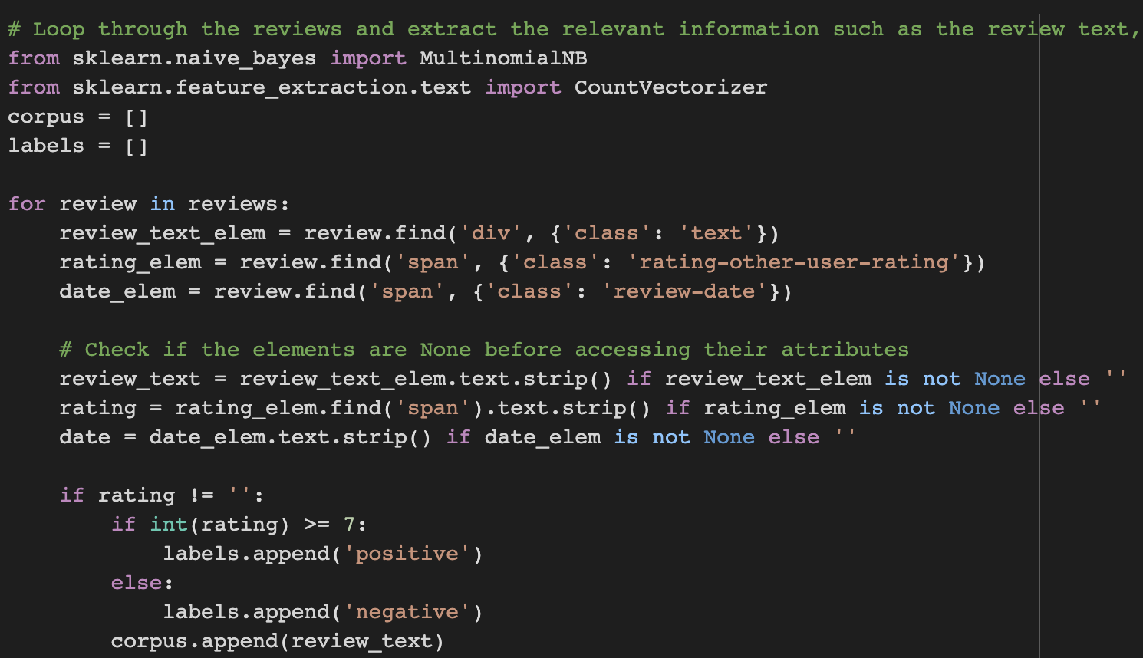
Web Scrapping

Slide 4
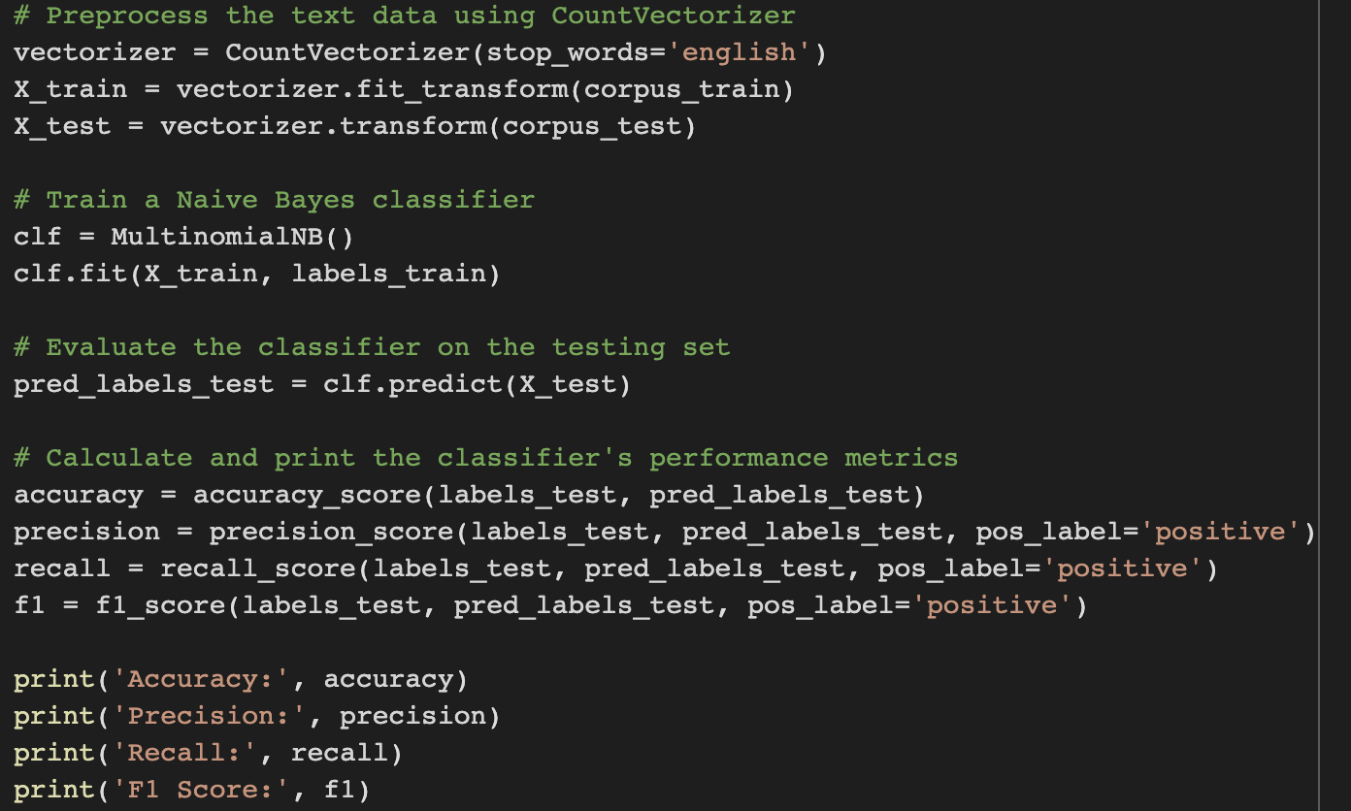
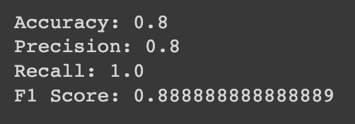
NBC Model
Corresponding Accuracies:

Slide 5
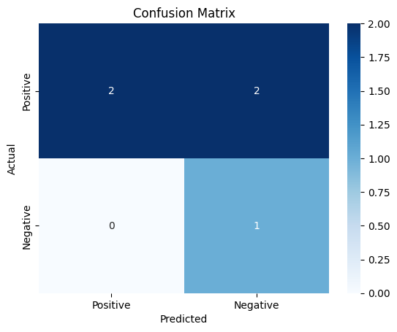
Results
Accuracy – 0.6000
Precision – 1.0
Recall – 0.500
F1 Score – 0.6667

